Slide 1
习题讲解

Slide 2
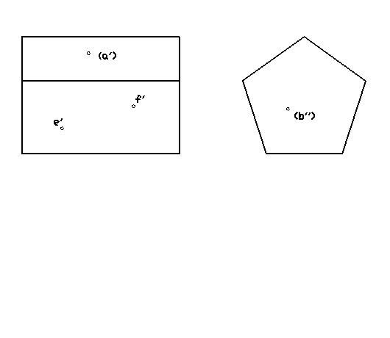
3-1(1)

Slide 3
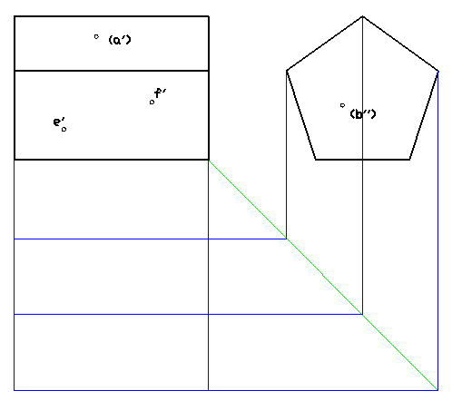
3-1(1)

Slide 4
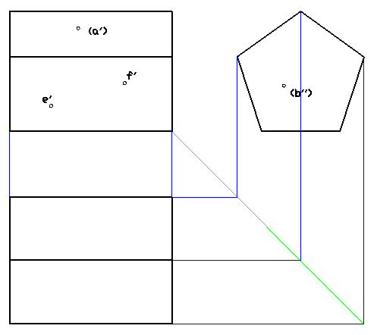
3-1(1)

Slide 5
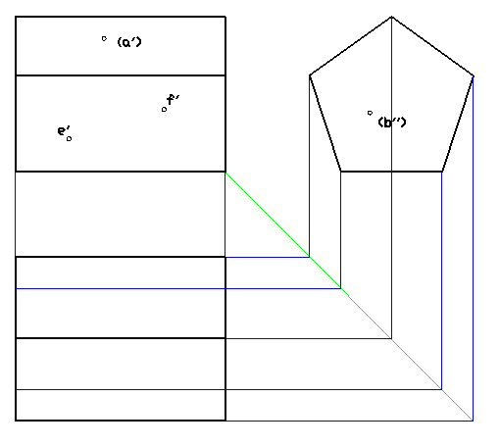
3-1(1)

Slide 6
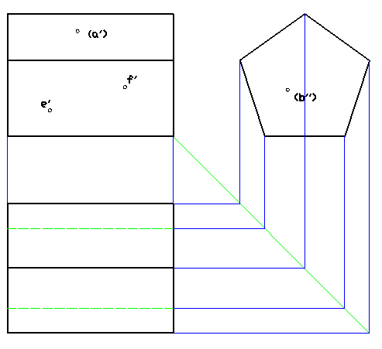
3-1(1)

Slide 7
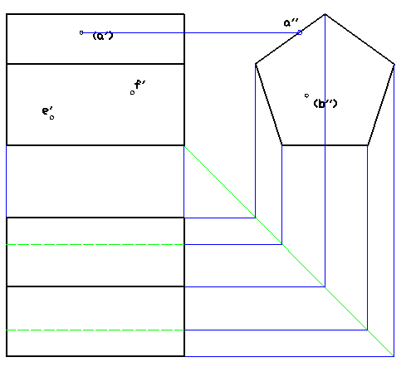
3-1(1)

Slide 8
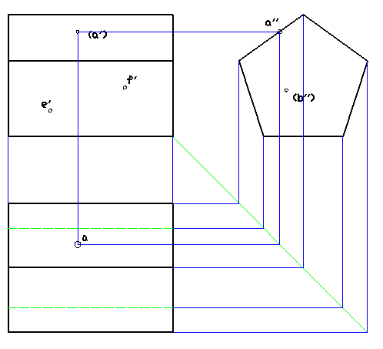
3-1(1)

Slide 9
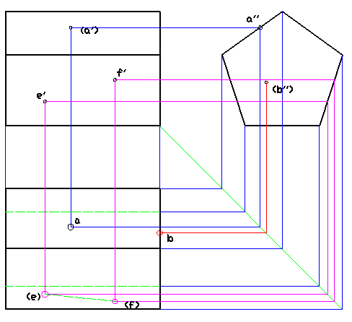
3-1(1)

Slide 10
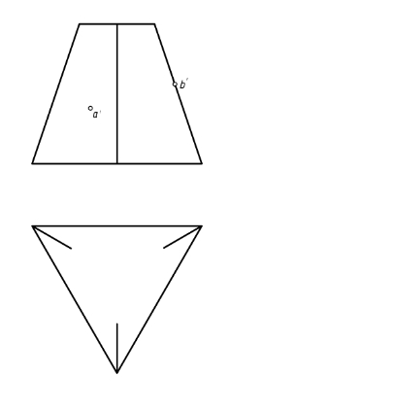
3-2(2)

Slide 11
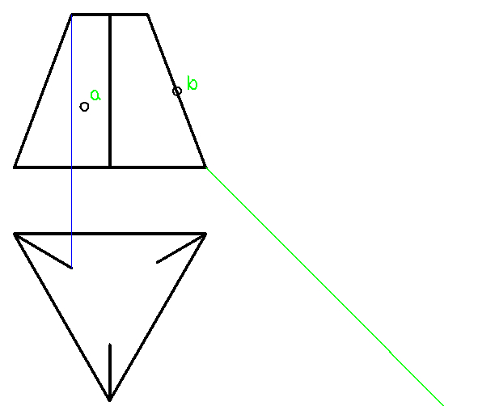

Slide 12
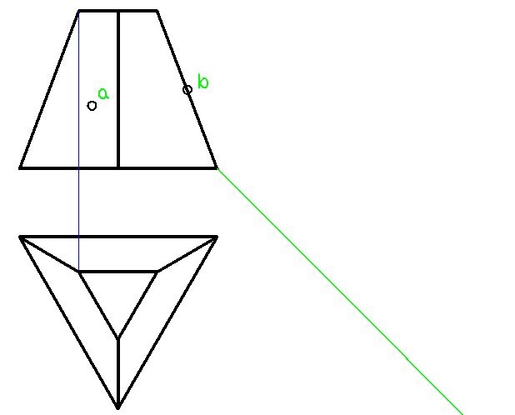

Slide 13
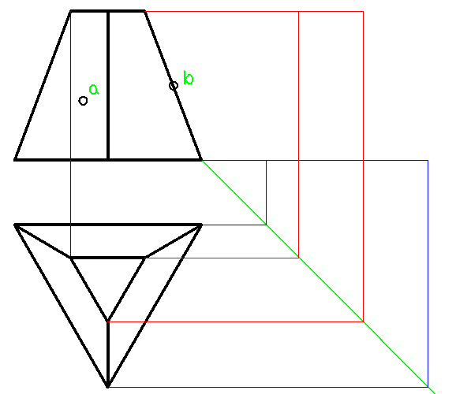

Slide 14
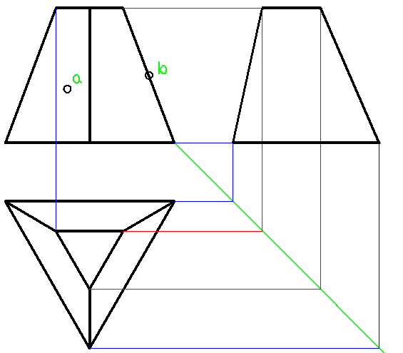

Slide 15
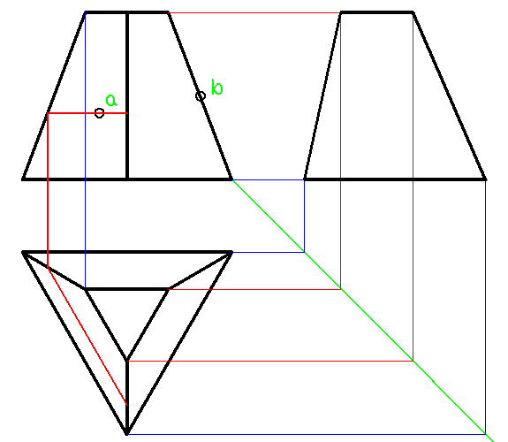

Slide 16
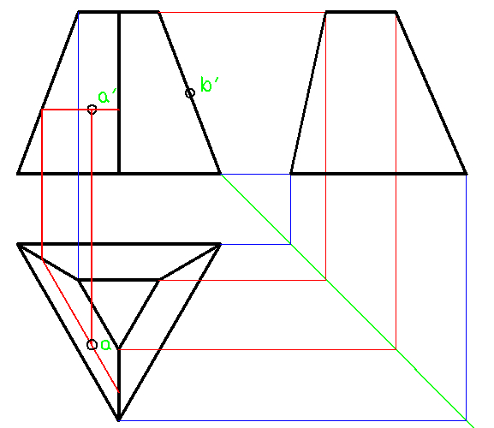

Slide 17
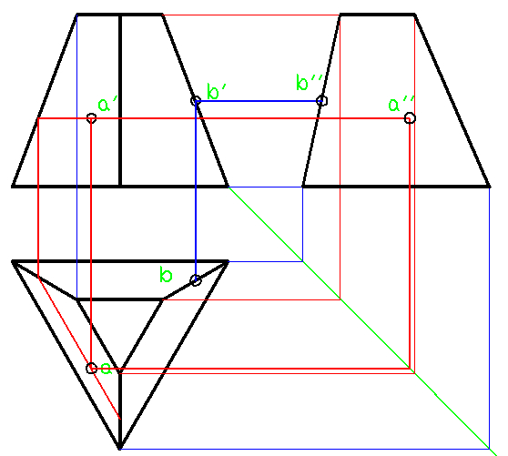

Slide 18
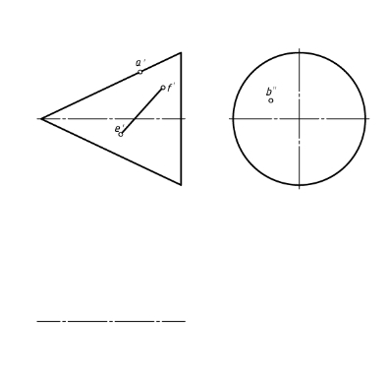
3-5(1)

Slide 19
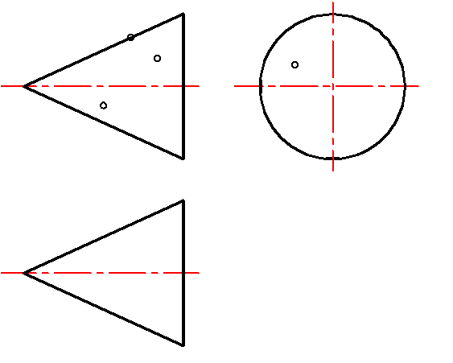

Slide 20
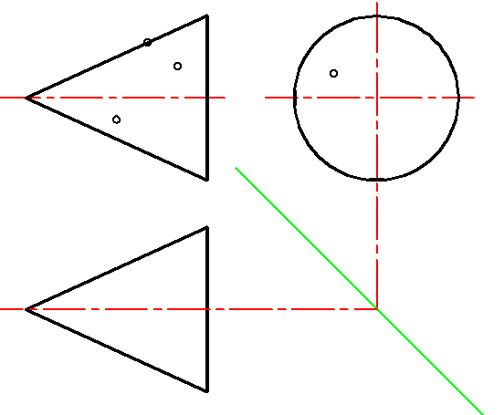

Slide 21
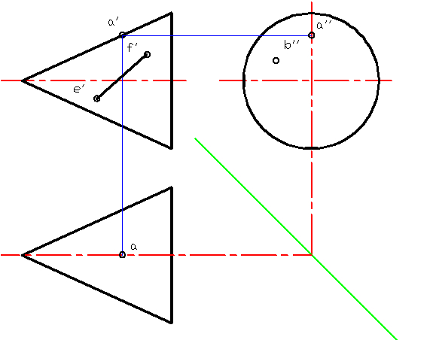

Slide 22
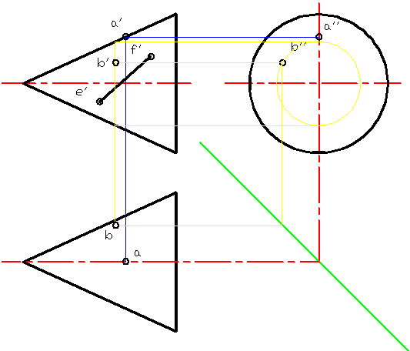

Slide 23
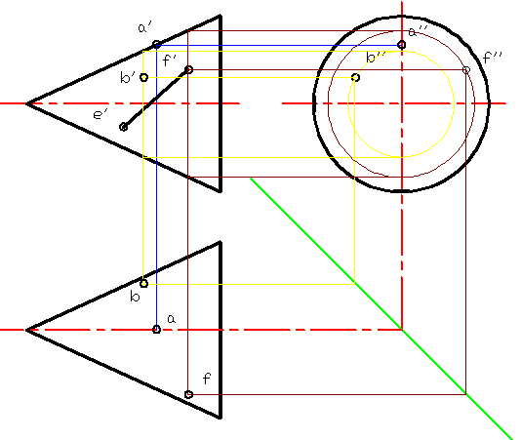

Slide 24
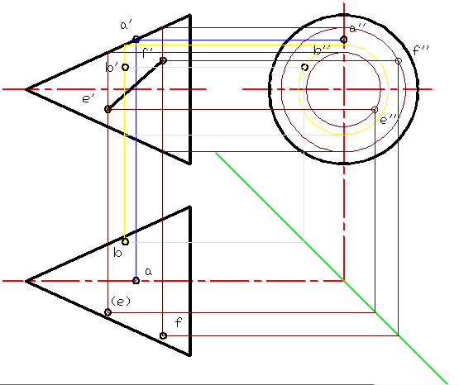

Slide 25
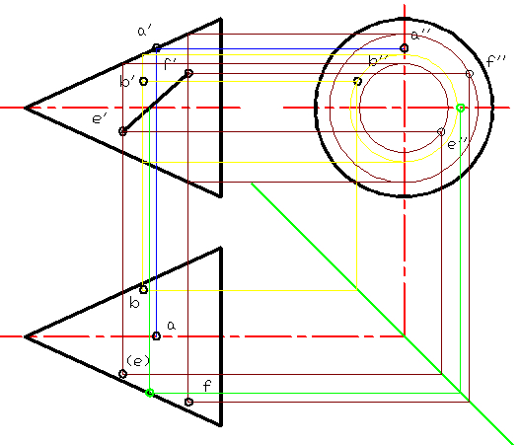

Slide 26
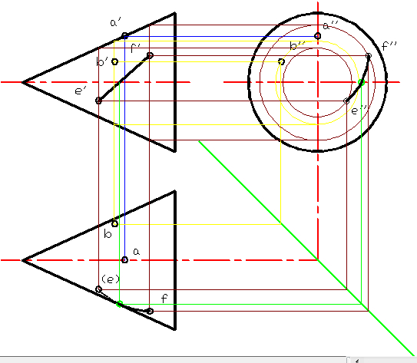
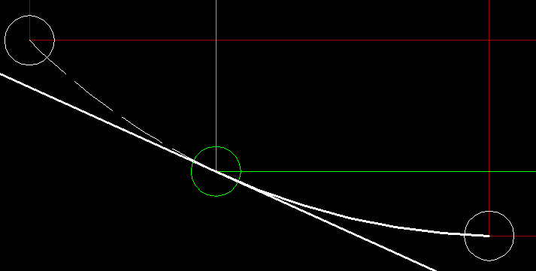

Slide 27
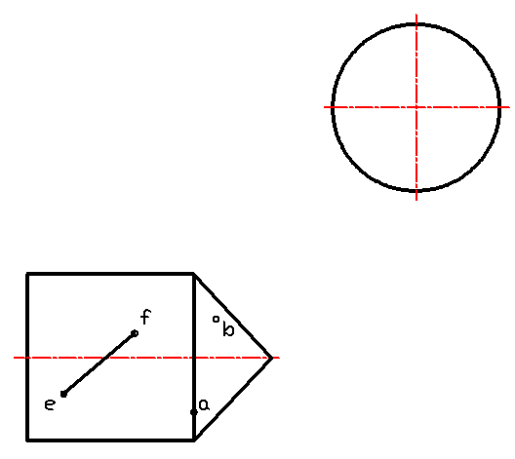
3-5(1)

Slide 28
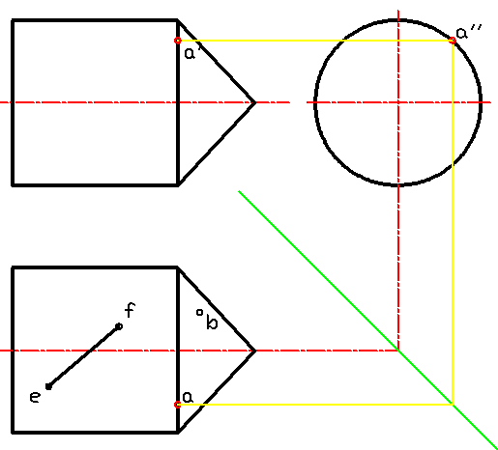

Slide 29
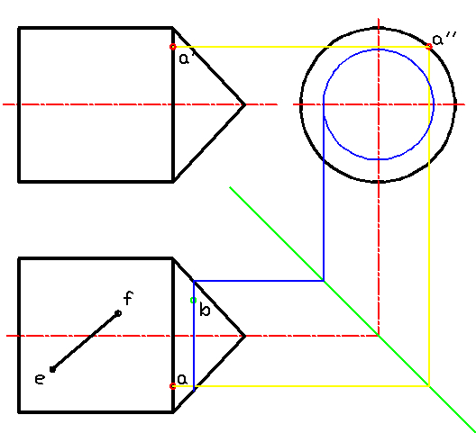

Slide 30
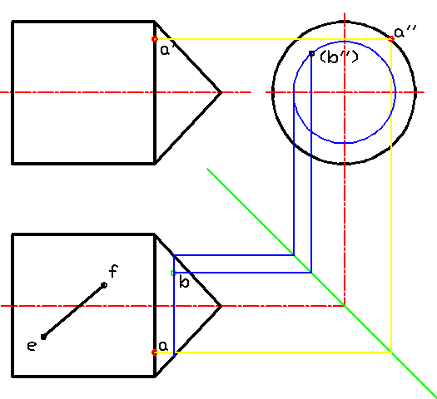

Slide 31
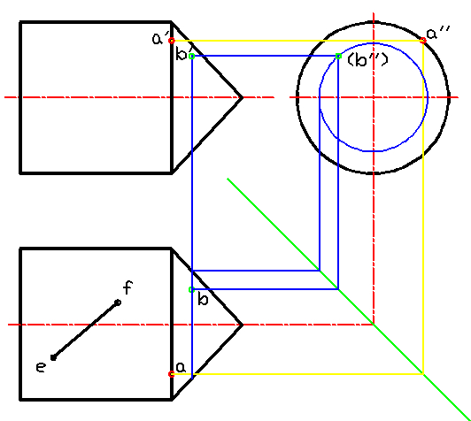

Slide 32
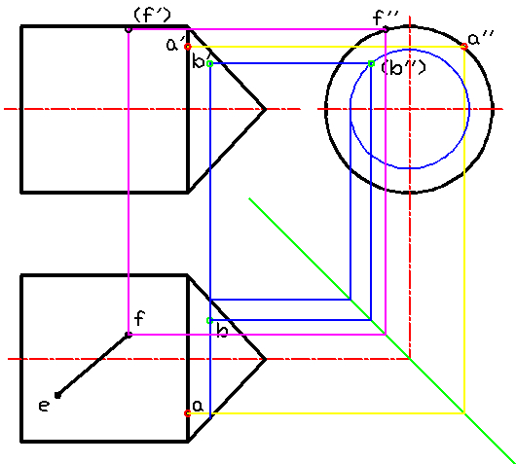

Slide 33
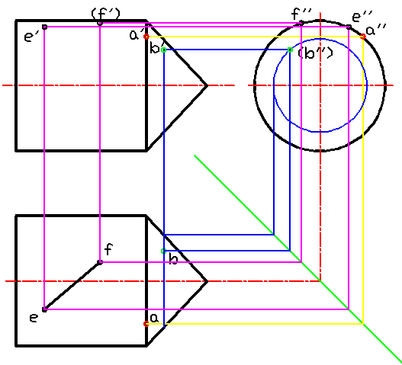

Slide 34
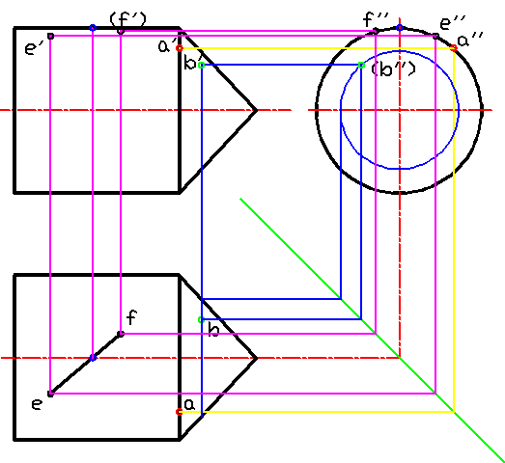

Slide 35

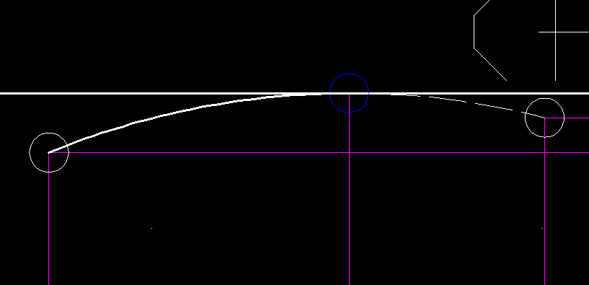

Slide 36
3-6(1)
(a')
a''
b’’
b'
c'
c''
a
b
c

Slide 37
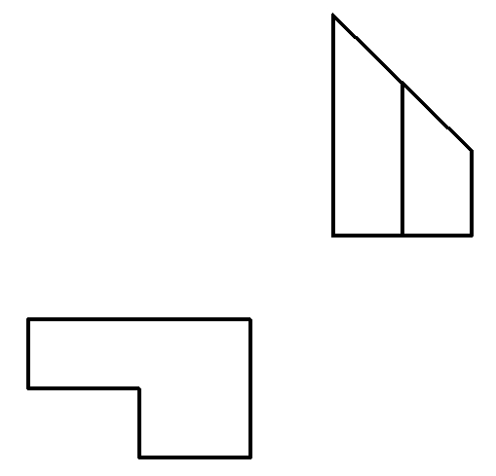
3-7(1)

Slide 38
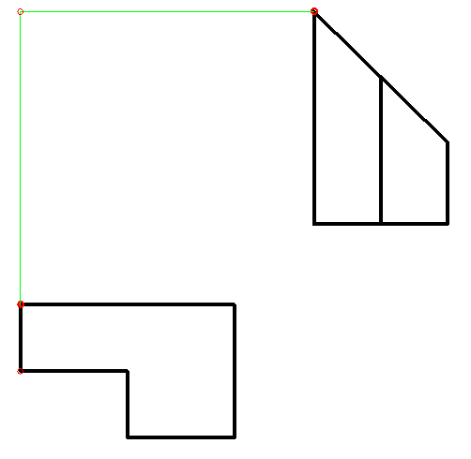

Slide 39
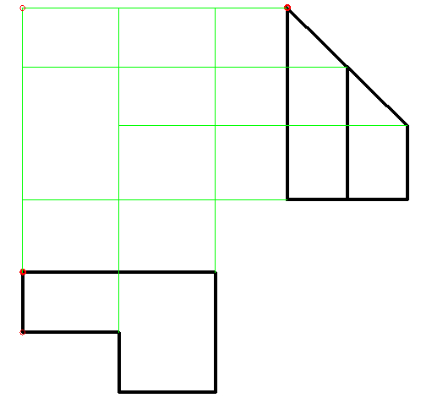

Slide 40
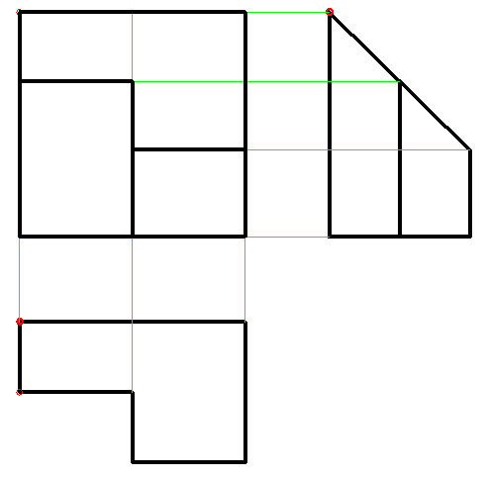

Slide 41
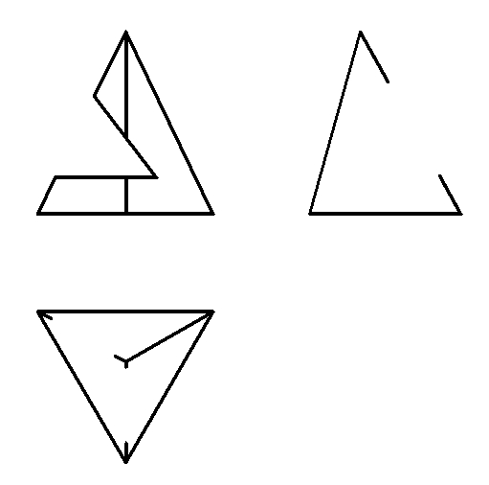
3-8(1)

Slide 42
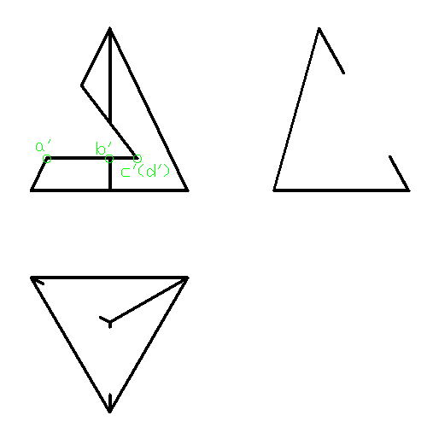

Slide 43
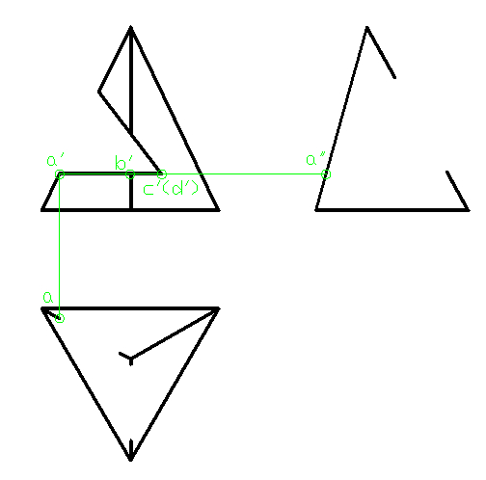

Slide 44
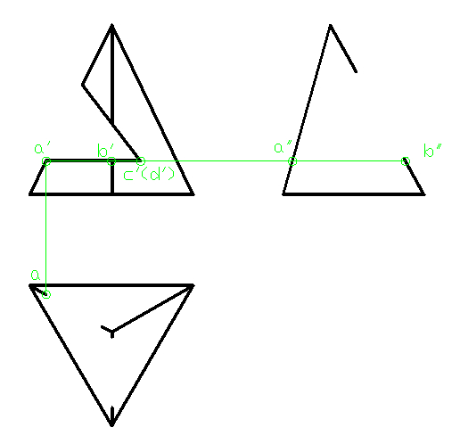

Slide 45
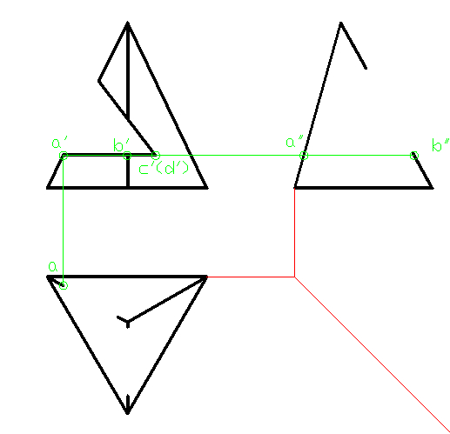

Slide 46
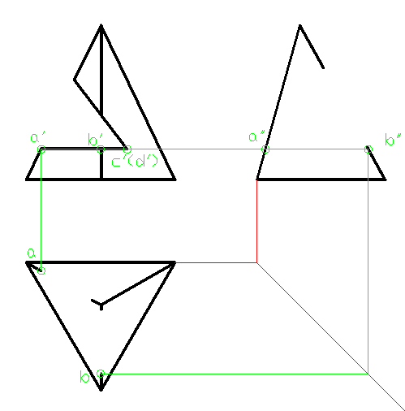

Slide 47
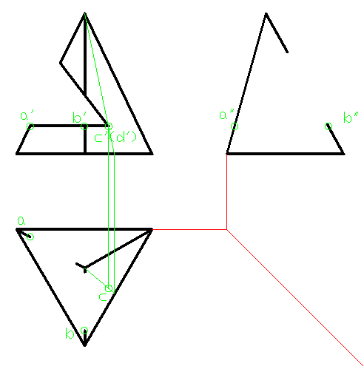

Slide 48
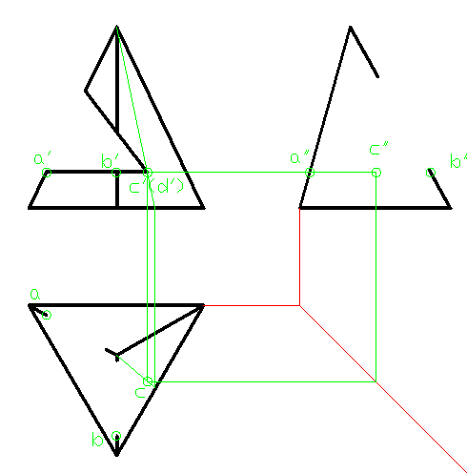

Slide 49
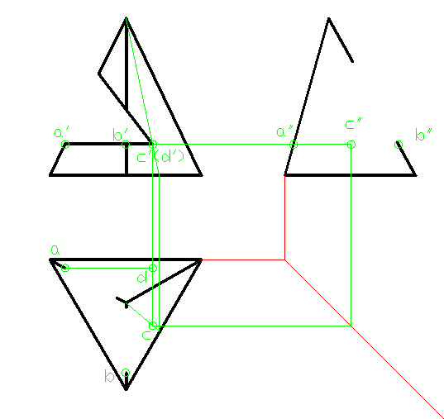

Slide 50
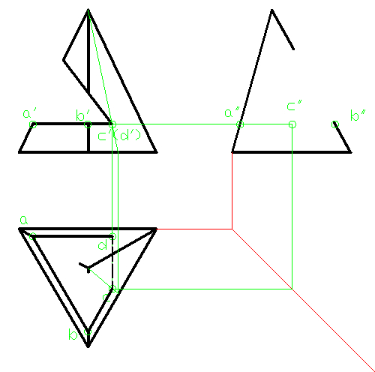

Slide 51
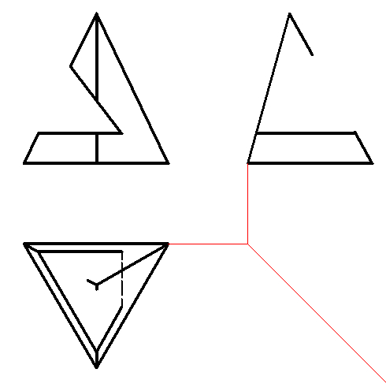

Slide 52


Slide 53


Slide 54


Slide 55


Slide 56

3-9(2)

Slide 57


Slide 58


Slide 59


Slide 60


Slide 61


Slide 62


Slide 63


Slide 64


Slide 65


Slide 66
3-10(2)
1’
1’’
2’(3’)
3’’
2’’
6’(7’)
4’(5’)
5’’
4’’
(7’’)
(6’’)
3
7
5
1
4
6
2

Slide 67

3-11(2)

Slide 68


Slide 69


Slide 70


Slide 71


Slide 72



Slide 73

3-12(1)

Slide 74


Slide 75


Slide 76


Slide 77


Slide 78

3-12(2)

Slide 79


Slide 80


Slide 81

3-13(4)

Slide 82


Slide 83


Slide 84


Slide 85


Slide 86

3-14(1)

Slide 87


Slide 88


Slide 89


Slide 90

3-16(2)

Slide 91


Slide 92


Slide 93


Slide 94


Slide 95


Slide 96


Slide 97

3-17

Slide 98


Slide 99


Slide 100


Slide 101


Slide 102


Slide 103


Slide 104


Slide 105



Slide 106
3-18

Slide 107
3-20

Slide 108

3-22

Slide 109


Slide 110


Slide 111


Slide 112



Slide 113

4-7(2)

Slide 114

4-8(2)

Slide 115

4-9(1)

Slide 116

4-9(2)

Slide 117

4-10(1)

Slide 118

4-12(1)

Slide 119

4-12(2)

Slide 120

4-15(2)

Slide 121
4-16(1)

Slide 122

6-7(2)

Slide 123

6-9

